Slide 1
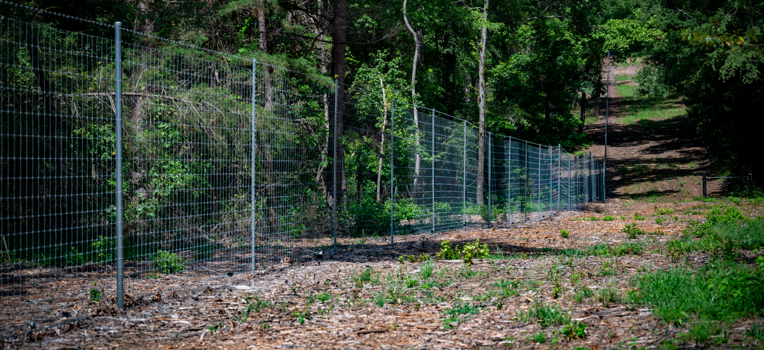

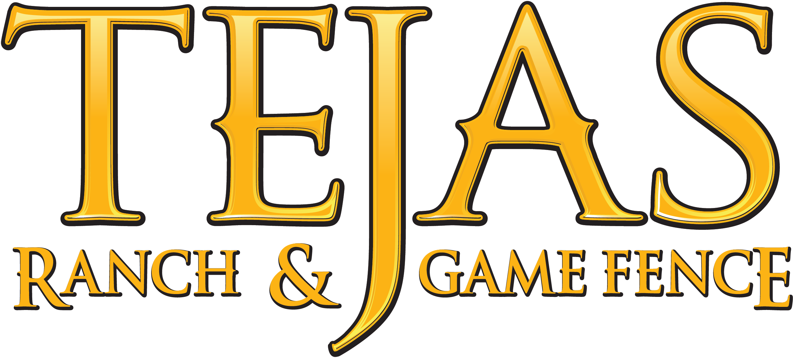
SERVING TEXAS &
SURROUNDING STATES
FENCING | LAND CLEARING | PROPERTY IMPROVEMENTS
Jessica Bass | Client Relations Manager

Slide 2
WHO WE ARE
A professional resource for landowners, ranch managers, brokers and their clients
Built Around the Land
Tejas helps landowners turn a vision for their property into a practical plan - from fencing and access to clearing and property improvements.
Experienced Team
Nearly 30 years of fencing experience, specialized equipment and crews prepared for large acreage and challenging terrain. Qualifying installations include a 20-year workmanship warranty.
Broad Service Area
Based in Athens, Texas, with work throughout Texas and into surrounding states. Our website specifically highlights projects in East Texas, the Hill Country, Oklahoma and Northern Louisiana.

Slide 3
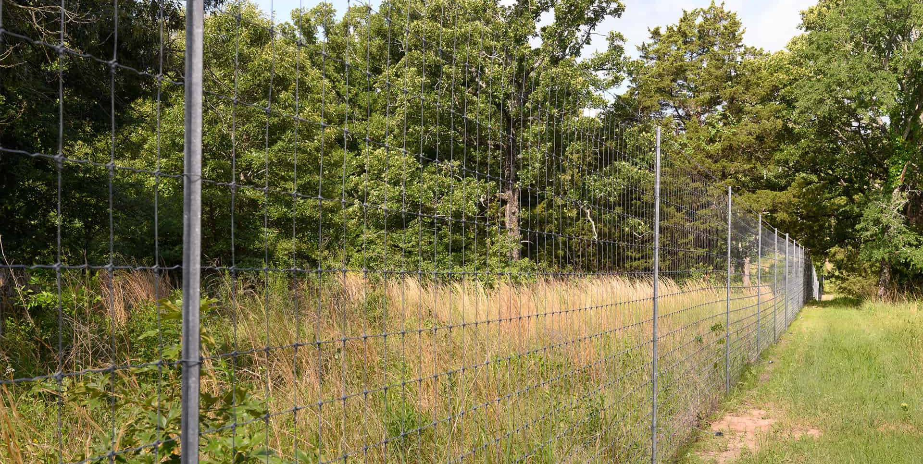
MORE THAN JUST FENCING
One team for the improvements that make acreage more usable, marketable and ready for the next owner
Custom Acreage
Solutions
Fencing
Land Clearing
High game fence
Agricultural & livestock fence
Horse fence
Hog / predator solutions
Water gaps
Brush & underbrush removal
Fence right-of-way clearing
Grazing preparation
Trail & access clearing
Property preparation
Custom ranch gates
& entries
Trail systems &
access roads
Recreational property setup
Fence repair & upgrades
Custom acreage solutions

Slide 4
WHEN SHOULD AN AGENT
THINK OF TEJAS?
These are the conversations where a quick introduction to Tejas can help your client move forward
The buyer loves the property...
but wants to know what replacing or adding fence could involve.
The acreage is hard to visualize...
because brush, access or overgrowth is hiding its potential
A client has a land-use goal...
grazing, wildlife, recreation, livestock or a future ranch setup.
The property needs work before market...
clearing, trails, access, fencing repairs or
other improvements.

Slide 5
BRING TEJAS INTO THE CONVERSATION
We can work directly with you, your client, or all together - whatever best supports the relationship.
Broker-Led
Direct Introduction
Work Together
You tell us what your client wants to accomplish.
Tejas evaluates the project and prepares the estimate.
You can take the information back to your client, and when they are ready, Tejas handles the contract
directly with the client
while you stay involved.
Introduce Tejas directly to your client.
We work with them on the property needs, site evaluation and estimate.
You remain part of the relationship and can stay involved throughout
the process.
Broker + Client + Tejas work together from
the beginning.
We can discuss the property's needs, options and priorities as a team - from evaluation and estimating through the decision to move forward.

Slide 6
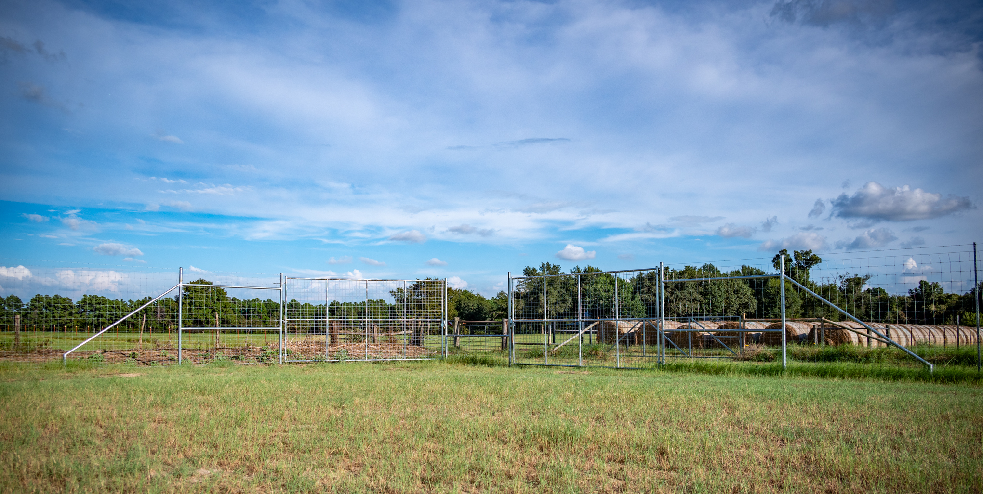
HOW THIS HELPS YOUR CLIENTS
A trusted contractor connection can give buyers and sellers clearer information about the property
Clearer Vision
Help buyers understand what a property could become - not just what it looks like today.
Practical Estimates
Give clients real information about project scope and investment during decision-making.
One Connection
A resource for fencing, clearing, access and multiple land-improvement needs.
Confident Referral
Connect clients with a professional team that can evaluate the property and communicate the next steps.

Slide 7
LET TEJAS BE PART OF YOUR TEAM.
Whether you want to make an introduction or work with us throughout the process,
we're here to help you serve your client.
Jessica Bass | Client Relations Manager
903-292-0525 | TejasRanchFence.com
QUESTIONS?

